Slide 1
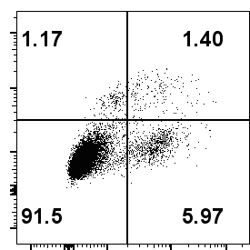
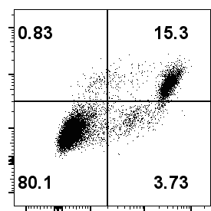
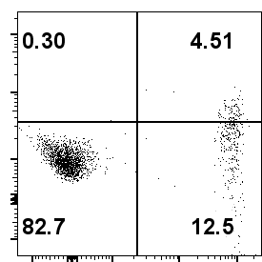
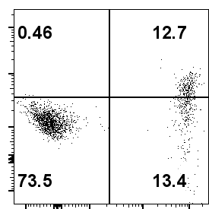
C
WSU-HN30
sh-NC
sh-hsa_circ_0000831
PI
ANNEXIN-V
C
HSC-3
sh-NC
sh-hsa_circ_0000831
PI
ANNEXIN-V

